Slide 1
Architecture and Software Product Lines
—— 2016/6
下午 09:50
60

Slide 2
Outline
Introduction
Product Line Scope
The Quality Attribute of Variability
The Role of a Product Line Architecture
Variation Mechanisms
Design Product Line Architecture
Evaluation a Product Line Architecture
Key Software Product Line Issues
下午 09:50
60

Slide 3

motto
Coming together is beginning
Keeping together is progress
Working together is success
下午 09:50
60

Slide 4
1. Introduction
A software architecture represents a significant investment of time and effort. We want to maximize the return by reusing an architecture across multiple system
For example, the patterns reuse a package of architectural decisions
Another way to reuse a software architecture across product line
下午 09:50
60

Slide 5
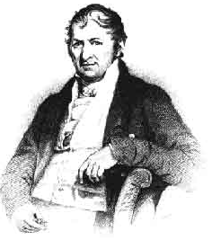

1.1 Reuse History
Product lines are nothing new in manufacturing.
Many historians trace the concept to Eli Whitney's use of interchangeable parts to build rifles in the early 1800s, but earlier examples also exist
Eli. Whitney and it’s design
下午 09:50
60

Slide 6
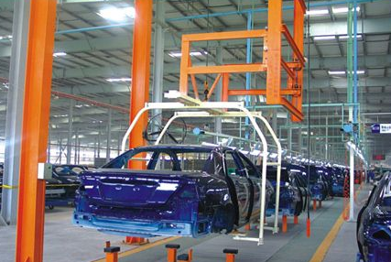
1.2 The Application of Product Lines in Manufacture
There are extensive application of product lines in the industrial manufacture
For example: automobile, airplane etc.
Various type cars are produced by same product lines
下午 09:50
60

Slide 7
1.3 The Concept of Product Lines
Product lines: a set of software-intensive systems sharing a common, managed set of features that satisfy the specific needs of a particular market segment or mission and that are developed from a common set of core assets in a prescribed way.
下午 09:50
60

Slide 8
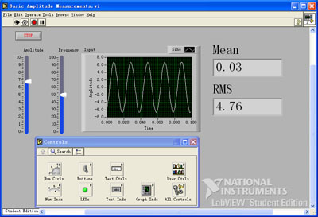
1.3.1 The Example——LabView
National instruments' LabView Software
下午 09:50
60

Slide 9
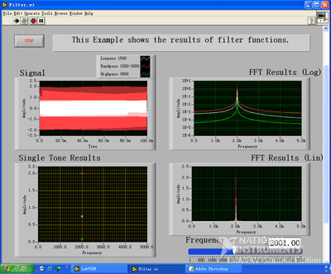
1.3.2 The Example LabView(1)
National instruments' LabView Software
下午 09:50
60

Slide 10
1.4 Advantage of Product Line
When a product line has been successfully established, each re-usable asset is saved in a core asset base because it can be applied to more than one system and because re-using it will be cheaper than re-inventing it
The product line improves the cost, quality, and time to market
下午 09:50
60

Slide 11
1.4.1 Core Assets of Product Lines
The core assets include:
Designs
Documentation
User manuals
Project management artifacts (budgets and schedules)
Test plans and test case
下午 09:50
60

Slide 12
1.4.2 Change Building Process
Once the core assets are in place, system building becomes a matter of
Accessing the appropriate assets in the core asset base
Exercising the variation points to configure them as required for the system being build
Assembling that system
下午 09:50
60

Slide 13
1.4.3 Example of Advantage
Cummins, Inc., was able to reduce the time it takes to produce the software for a diesel engine from about a year to about a week
Hewlett-Packard uses 1/4 starff, 1/3 time, and 1/25 defects by product line
The U.S. National Reconnaissance Office reports the first product requiring 10% the expected number of developers and having 10% of the defects with product line
下午 09:50
60

Slide 14
1.5 An Example of Product Line Variability
In a product line of software to support U.S. bank loan office
For 18 of the 21 products in product line, the module calculating customer owes is completely adequate
However, three products well be planned to sell in Delaware need modify the module
下午 09:50
60

Slide 15
1.5.1 How Can We Change
Analysis shows that the difference will affect about 250 lines of source code in 8000-line module
A obvious option is to cop the model, change the 250 lines, and sue the new version in the three products.
This practice if called “clone-and-own”，the projects clone the module, change it, and then own the new version
下午 09:50
60

Slide 16
1.5.3 Shortcoming of Clone-and-Own
The problem with clone-and-own is that it doesn’t scale
Suppose each of 21 products comprises roughly 100 modules. If each module is allowed to diverge for each product, that’s potentially 2,100 modules that the maintenance staff has to deal with
下午 09:50
60

Slide 17
1.5.4 Variation Mechanism
Instead of maintaining much versions, we use multiple common module, and only identify the small various module
We introduce a variation mechanism, for example, defer binding
The variation mechanism will let us maintain a single module that can adapt to the range of variation in the application
下午 09:50
60

Slide 18
1.6 What Makes Software Product Lines Work
The essence of a software product line is the disciplined, strategic re-use of assets in producing a family of products.
What makes product lines succeed is that the commonalities shared by the products can be exploited through re-use to achieve production economies.
The potential for re-use is broad and far-ranging,
下午 09:50
60

Slide 19
1.6.1 Re-Use Part(1)
Requirements
Most of the requirements are common with those of earlier systems and so can be re-used
Architectural design
An architecture for a software system represents a large investment of time from the organization's most talented engineers. For a new product, however, this most important design step is already done and need not be repeated
下午 09:50
60

Slide 20
1.6.2 Re-Use Part(2)
Software Elements
This includes design of the element's interface, its documentation, and procedures, and any models
Modeling and analysis
Performance models, schedulability analysis, distributed system issues.
Testing
Test plans, test processes, test cases, test data, test harnesses, and fix problems are already in place
下午 09:50
60

Slide 21
1.6.3 Re-Use Part(3)
Project planning
Budgeting and scheduling are more predictable because experience is a high-fidelity indicator of future performance
Processes, methods, and tools
Configuration control procedures and facilities, documentation plans and approval processes, tool environments, system generation and distribution procedures, coding standards
下午 09:50
60

Slide 22
1.6.4 Re-Use Part(4)
People
personnel can be fluidly transferred among projects as required.
Exemplar systems
Deployed products serve as high-quality demonstration prototypes.
Defect elimination
Product lines enhance quality because each new system takes advantage of the defect elimination in its forebears.
下午 09:50
60

Slide 23
3. Scoping
A product line’s scope is a statement about what systems an organization is willing to build as part of its line and what systems is not willing to build
Input to the scoping process comes from the organization‘s strategic planners, marketing staff, domain analysts who can catalog similar systems, and technology experts
下午 09:50
60

Slide 24

3.1 The Space of All Possible Systems
A product line scope is a critical factor in the success of the product line
It isn’t too narrow(>3) or too broad
within scope (white)
require case-by-case disposition (black)
outside of scope (speckled)
下午 09:50
60

Slide 25
3.2 Scope is Vital to Product Line
The scope definition is vital to the product line architect because the scope defines what is common across all members of the product line, and the specific ways in which the products differ from each other
下午 09:50
60

Slide 26
4. The Quality Attribute of Variability
The quality attribute of variability is most closely associated with product lines
All product lines feature variability aimed at satisfying the commonalities and variations identified by the product line’s scope
下午 09:50
60

Slide 27
4.1 The feature of Variability
The variability is a special from of modifiability, pertaining to the ability of a core asset to adapt to usages in the different product contexts that are within the product line scope
The goal of variability in a software product line is to make it easy to build and maintain products in the product line over time
下午 09:50
60

Slide 28
4.2 The General Scenario of Variability
Source: Actor requesting variability
Stimulus:
Requests to support variations in the following：Hardware, Feature sets, Technologies, User interfaces, quality attributes and more
For the range of products affected, such as: All, A specified subset, Those that include feature set x and new product
下午 09:50
60

Slide 29
4.2.1 The General Scenario of Variability (continue)
Environment: Variants are to be created at: Runtime, Build time, Development time
Artifact: Asset(s) affected, such as: Requirements, Architecture, Component, Test suite y, Project plan z, and more
下午 09:50
60

Slide 30
4.2.2 The General Scenario of Variability (continue)
Response: The requested variants can be created
Response measure: A specified cost and/or time to create the core assets and to create the variants using these core assets
下午 09:50
60

Slide 31
5. The Role of a Product Line Architecture
Of all of the assets in a core asset repository, the software architecture plays the most central role
There is both a tactical and strategic reason
下午 09:50
60

Slide 32
5.1 The Tactical Reason
The tactical reason is the importance the architecture plays in building products in a product line
The essence of building a successful product line is discriminating between constant and variety
Software architecture is ideal for handling this variation, for example, interfaces remain stable with changes
下午 09:50
60

Slide 33
5.2 The Strategic Reason
The strategic reason has to do with the capability it imparts to organization outside the realm of an existing product line
An architecture can serve as a technical platform for launching new applications and even business model, and it can serve as a springboard for an organization diving into a new business area
下午 09:50
60

Slide 34
5.3 Product line Architecture to be Considered
A product line architect needs to consider three things:
Identifying variation points
Supporting variation points
Evaluating the architecture for product line suitability
下午 09:50
60

Slide 35
6. Variation Mechanisms
Three primary architectural variation mechanisms are these
Inclusion or omission of elements
Inclusion of a different number of replicated elements
Selection of different version of elements that have the same interface but different behavioral or quality attribute characteristics
下午 09:50
60

Slide 36
6.1 More Sophisticated Techniques
Extension points: identifying where additional behavior can be safely added
Reflection（反射）: reflective programs can adjust their behavior based on their context
Overloading（重载）: this is a means of reusing a named functionality to operate on different types
下午 09:50
60

Slide 37
6.2 Variation Mechanism Affects Numerous Costs
The skill set required to implement, or learn and use, the specific variation mechanism need program
The one-time costs of building or acquiring the tools required to create the variation mechanism
The recurring cost and time to exercise the variation mechanism
下午 09:50
60

Slide 38
6.3 Variation Mechanism Affects Product Quality
The impact of the variation mechanism on quality, such as possible performance penalties or memory consumption
The impact on the mechanism’s maintainability
下午 09:50
60

Slide 39
6.4 Common Variation Mechanism
Variation Mechanism | Properties Relevant to Building the Core Assets | Properties Relevant to Exercising the variation Mechanism When Building Products
Inheritance Specializing or generalizing a particular class | Cost: Medium Skills: Object-oriented languages | Stakeholder: Product developers Tools: Compiler Cost: Medium
Component substitution | Cost: Medium Skills: Interface definitions | Stakeholder: Product developers, system administrator Tools: Compiler Cost: Low
Add-one, plug-ins | Cost: High Skills: Framework programming | Stakeholder: End user Tools: None Cost: Low
下午 09:50
60

Slide 40
6.4.1 Common Variation Mechanism (Continue1)
Variation Mechanism | Properties Relevant to Building the Core Assets | Properties Relevant to Exercising the variation Mechanism When Building Products
Templates | Cost: Medium Skills: Abstractions | Stakeholder: Product developers, system administrator Tools: None Cost: Medium
Parameters (including text preprocessors) | Cost: Medium Skills: No special skills required | Stakeholder: Product developers, system administrator, end user Tools: None Cost: Low
Generator | Cost: High Skills: Generative programming | Stakeholder: system administrator, end user Tools: Generator Cost: Low
下午 09:50
60

Slide 41
6.4.2 Common Variation Mechanism (Continue2)
Variation Mechanism | Properties Relevant to Building the Core Assets | Properties Relevant to Exercising the variation Mechanism When Building Products
Aspects | Cost: Medium Skills: Aspect-oriented programming | Stakeholder: Product developers Tools: Aspect-oriented language compiler Cost: Medium
Runtime conditionals | Cost: Medium Skills: No special skills required | Stakeholder: None Tools: None Cost: No development cost; some performance cost
Configurator | Cost: Medium Skills: No special skills required | Stakeholder: Product developers Tools: Configurator Cost: Low to medium
下午 09:50
60

Slide 42
7. Design Product Line Architecture
A product line architect needs to consider three things:
Identifying variation points
Supporting variation points
Evaluating the architecture for product line suitability
下午 09:50
60

Slide 43
7.1 Identifying Variation Points
Variants can be identified at virtually any time during the development process.
Some variations are identified during product line requirements elicitation; others, during architecture design; and still others, during implementation.
下午 09:50
60

Slide 44
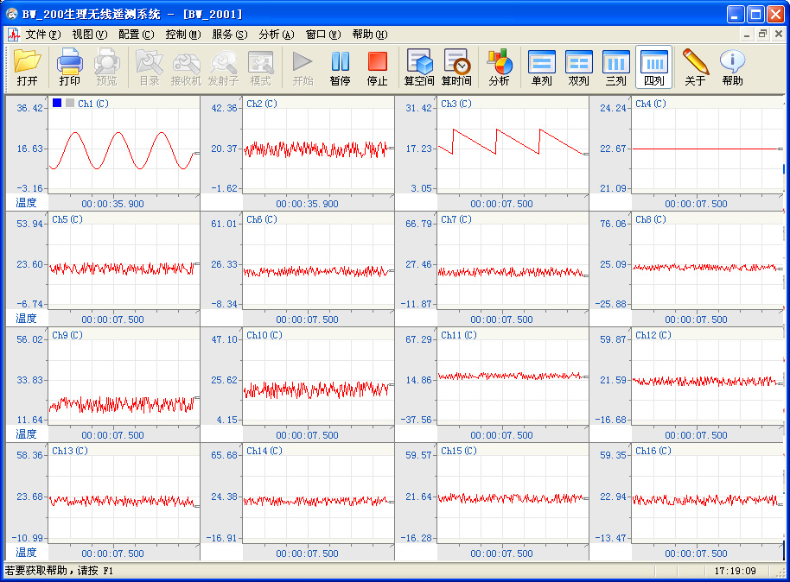
7.1 Example
Variation points in data acquisition and analysis system:
Channel Numbers(1-n)
Data Formats (edf, tme)
Communication methods (USB，Network)
下午 09:50
60

Slide 45
7.2 Supporting Variation Points
In a software product line, architectural support for variation can take many forms
Refer to the variation mechanism
下午 09:50
60

Slide 46
7.2.1 Other Techniques
In object-oriented systems, specializing or generalizing particular classes can achieve variation
Variation can be accomplished by introducing build-time parameters to an element
Overloading is a means of re-using a named functionality to operate on different types
下午 09:50
60

Slide 47
8. Evaluation a Product Line Architecture
The evaluation will have to focus on the variation points to make sure:
They are appropriate
They offer sufficient flexibility to cover the product line's intended scope
They allow products to be built quickly
They do not impose unacceptable runtime performance costs
下午 09:50
60

Slide 48
9. Key Software Product Line Issues
What Makes Software Product Lines Difficult:
Technology is not the only barrier to product line; organization, process, and business issues are equally vital
Configuration management is also an important activity for any project but is more complex for a software product line because each product is the result of binding a large number of variations
下午 09:50
60

Slide 49
9.1 The Factors of Product Line failure
Lack of a champion in a position of sufficient control and visibility
Failure of management to provide sustained and unwavering support
Reluctance of middle managers to relinquish autocratic control of projects
Failure to clearly identify business goals
Abandoning the approach at the first sign of difficulty
Failure to adequately train staff in the approach and failure to explain or justify the change adequately
下午 09:50
60

Slide 50
9.2 Adoption Strategies
One good strategy is to launch a small but visible pilot project to demonstrate the quantitative benefits of software product lines.
Top-down adoption comes when a manager decrees that the organization will use the approach
Bottom-up adoption happens when designers and developers working at the product level realize that they are needlessly duplicating each other's work and begin to share resources and develop generic core assets
下午 09:50
60

Slide 51
9.3 Two Primary Models
The proactive model
In a proactive product line, an organization defines the family using a comprehensive definition of scope
It allows the organization to make the most far-reaching strategic decisions
The proactive model requires an initial investment but less rework than the reactive model
下午 09:50
60

Slide 52
9.3.1 Two Primary Models (Continue)
The reactive model
The reactive model puts much less emphasis on upfront planning and strategic direction setting. Rather, the organization lets itself be taken where the market dictates
The reactive model relies exclusively on rework with little initial investment.
下午 09:50
60

Slide 53
9.4 Evolution of Product Line
That evolution will be driven by both external and internal sources:
External sources
New versions of elements in the line will be released by their vendors ；
Externally created elements may be added to the product line ；
Features may be added to the product lines
Internal sources
It must be determined if new functions added to a product are within the product line's scope
下午 09:50
60

Slide 54
9.5 Organizational Structure
Development department
All software development is concentrated in a single unit.
This model appears in small organizations and those that provide consulting services (<30 employees )
下午 09:50
60

Slide 55
9.5.1 Organizational Structure (continue)
Business units
Each business unit is responsible for a subset of the systems in the product family
It suffers from the risk that a business unit will focus on its own products first and the good of the product line will take a back seat (30~100 employees )
下午 09:50
60

Slide 56
9.5.2 Organizational Structure (Continue1)
Domain engineering unit
A special unit is given responsibility for the development and maintenance of the core asset base, from which business units build the products (>100 employees)
下午 09:50
60

Slide 57
9.5.3 Organizational Structure (Continue2)
Hierarchical domain engineering units
It may pay to regard hierarchically a product line that is very large and/or very complex
下午 09:50
60

Slide 58
Summary
The product line approach is steadily climbing in popularity as more organizations see true order-of-magnitude improvements in cost, schedule, and quality from using it
Architecturally, the key is identifying and managing commonalities and variations, but nontechnical issues must be addressed as well, including model, organization structure
下午 09:50
60

Slide 59
Homework
Do the list of variation mechanisms in this chapter constitute tactics for variability? Discuss
下午 09:50
60

Slide 60
Discuss
How much benefits does the product line bring?
下午 09:50
60

